Slide 1



Olympic Data Analytics End to end data Engineering project
By Bhavana Jaiswal

Slide 2

Agenda
1. Introduction
2. Data Collection and Preparation
3. Data Storage and Management
4. . Data Exploration and Analysis with Azure Databricks
5. Advanced Analytics with Azure Synapse Analytics
6. Conclusion and Insights
Microsoft Azure

Slide 3
Introduction
Greetings! I'm Bhavana Jaiswal, and I invite you to embark on an illuminating journey into the realm of data engineering with a focus on the Olympic Games. In this project, we leverage the transformative power of Azure's cutting-edge technologies to delve into Olympic data, uncovering hidden trends, athlete performance metrics, and historical patterns. From data collection and preparation to advanced analytics, our exploration is anchored in key tools like Azure Data Factory, Azure Data Lake Storage Gen 2, Azure Synapse Analytics (formerly SQL Data Warehouse), and the dynamic capabilities of Azure Databricks. By harnessing these technologies, we illuminate the potential of data engineering to drive informed decision-making and shape a data-driven future. Let's dive into the world of Olympic insights and Azure's prowess together!

Slide 4
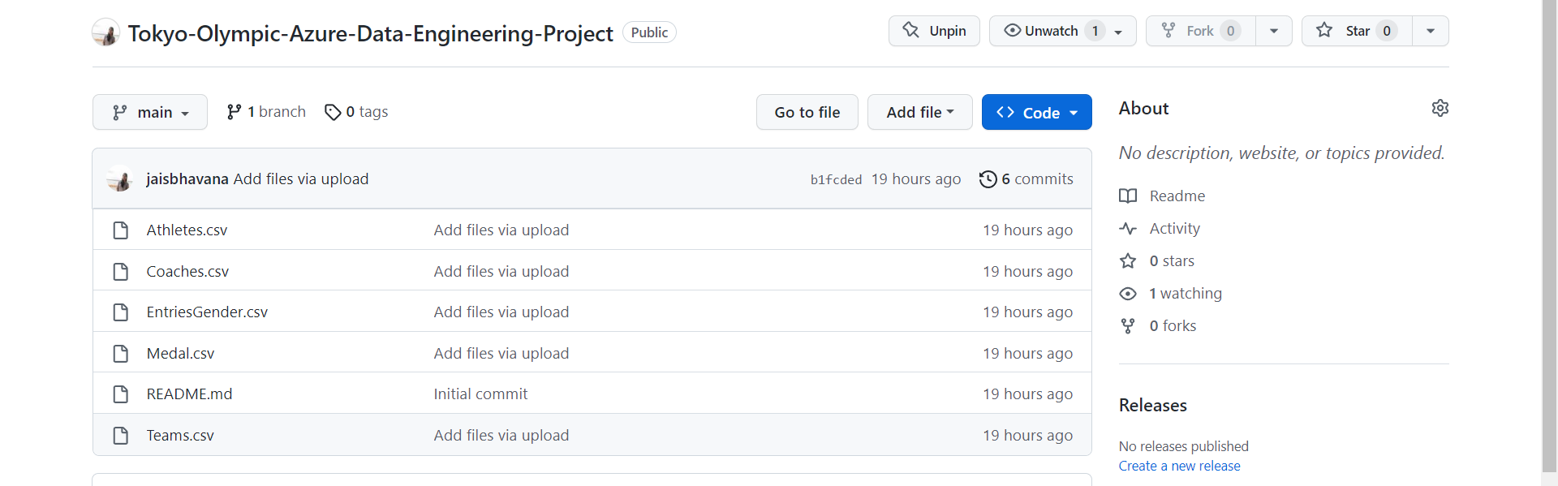

Slide 5
Creating Azure data factory studio
Welcome to the realm of Azure Data Factory Studio, where data movement transforms into a symphony of seamless orchestration. In our journey of unraveling Olympic insights, we delve into this powerful tool to craft robust, automated data pipelines that bridge diverse data sources. Azure Data Factory Studio empowers us to efficiently extract, transform, and load (ETL) Olympic data, ensuring its harmonious flow across the Azure landscape. As we curate this intricate melody of data, we discover how Azure Data Factory Studio simplifies the complex, making data movement a well-choreographed performance.

Slide 6
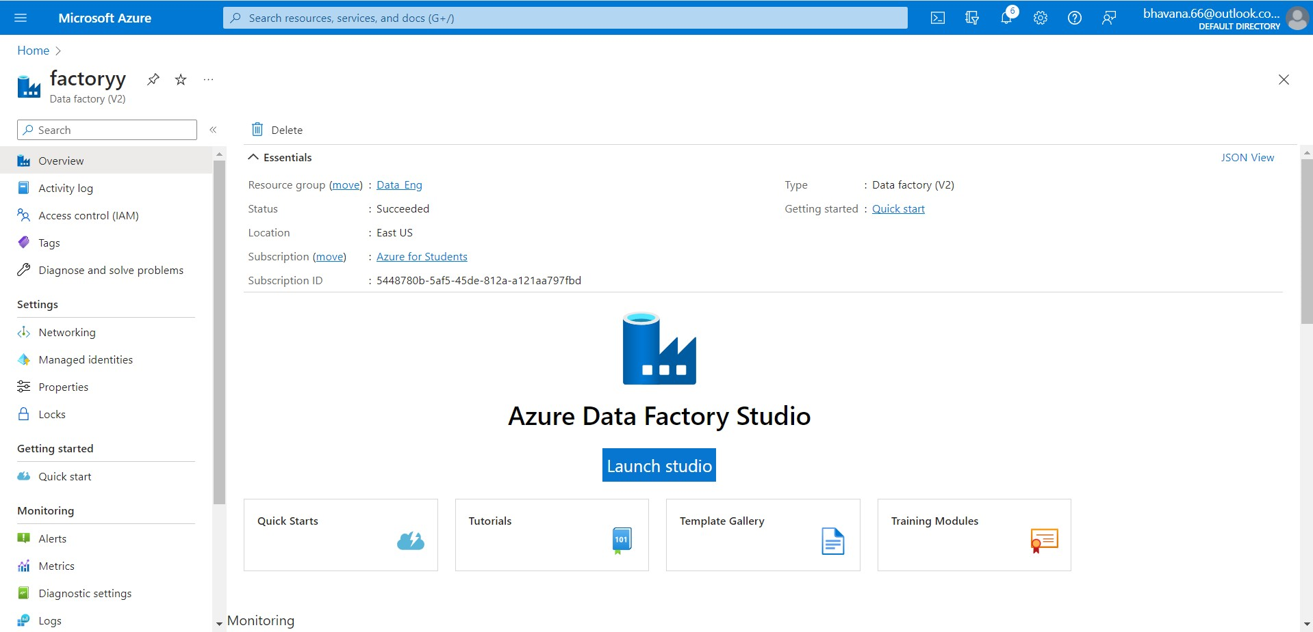

Slide 7
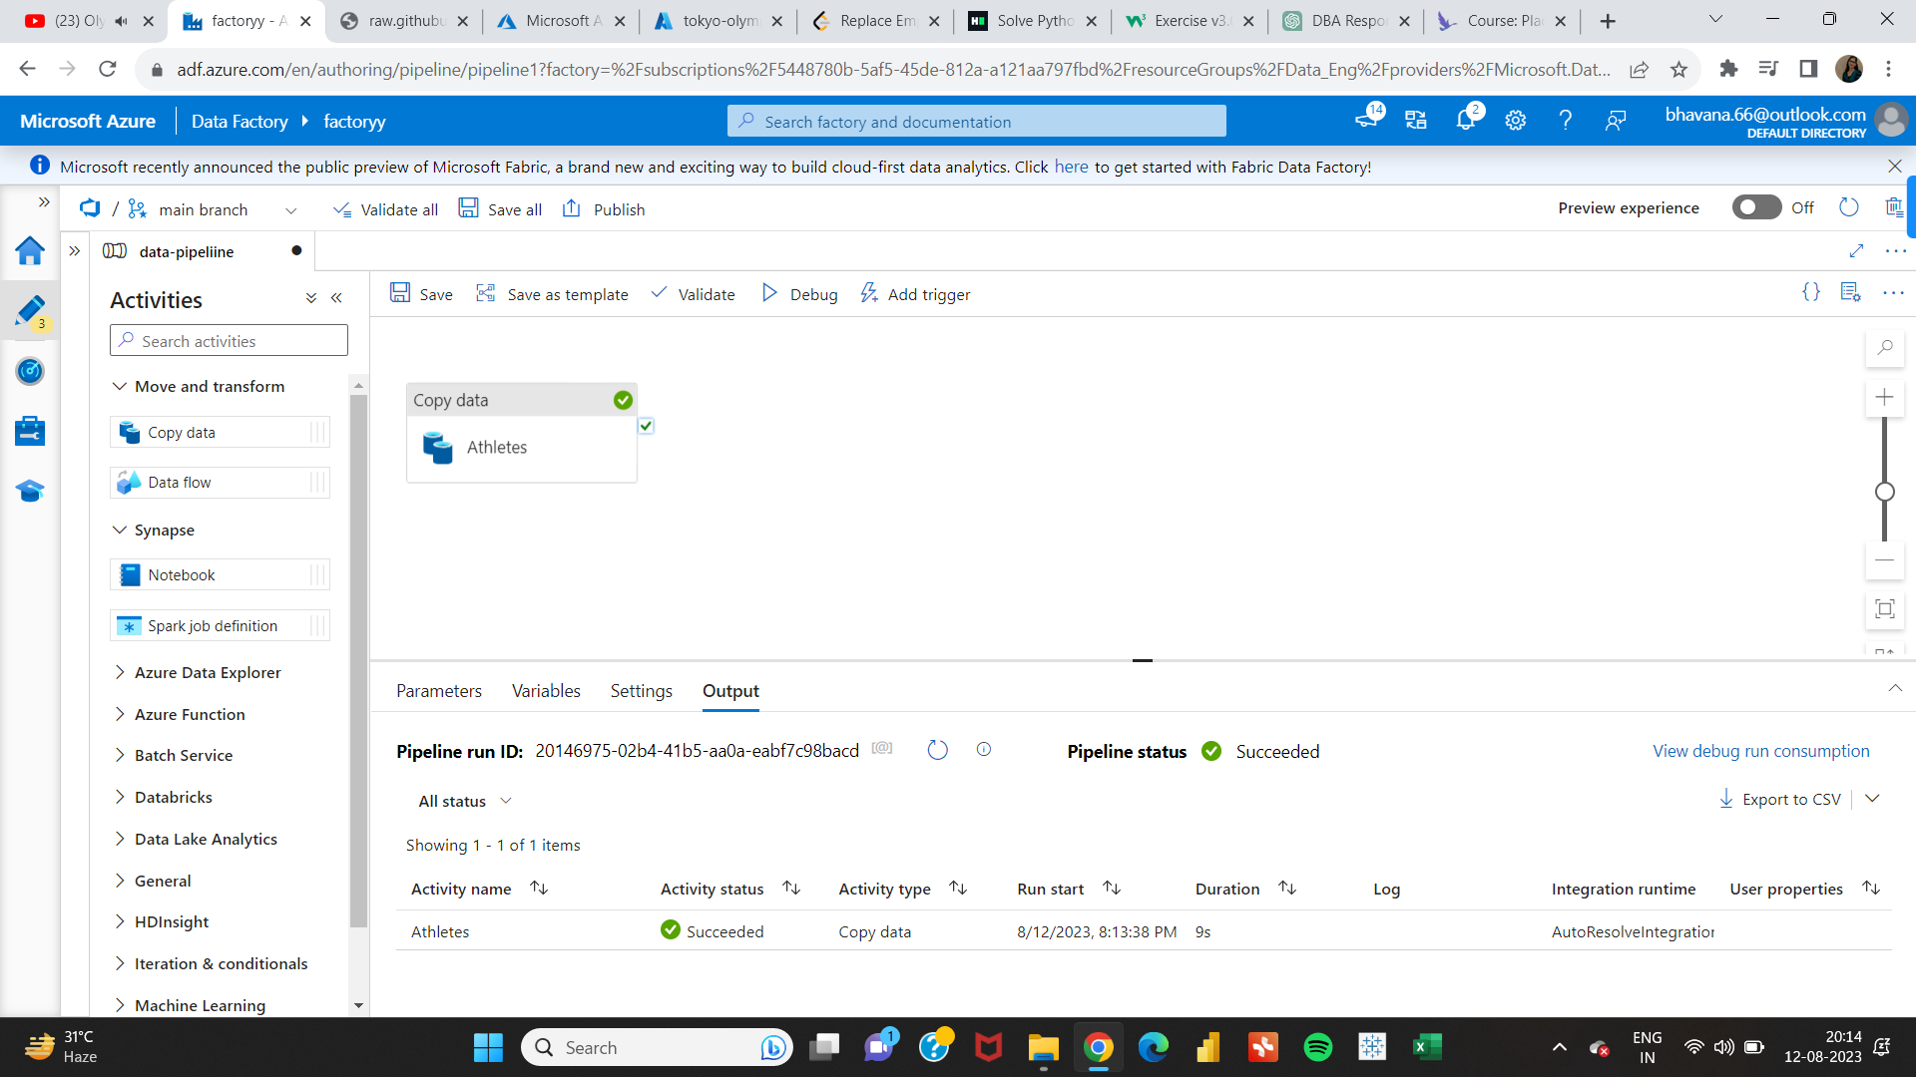

Slide 8
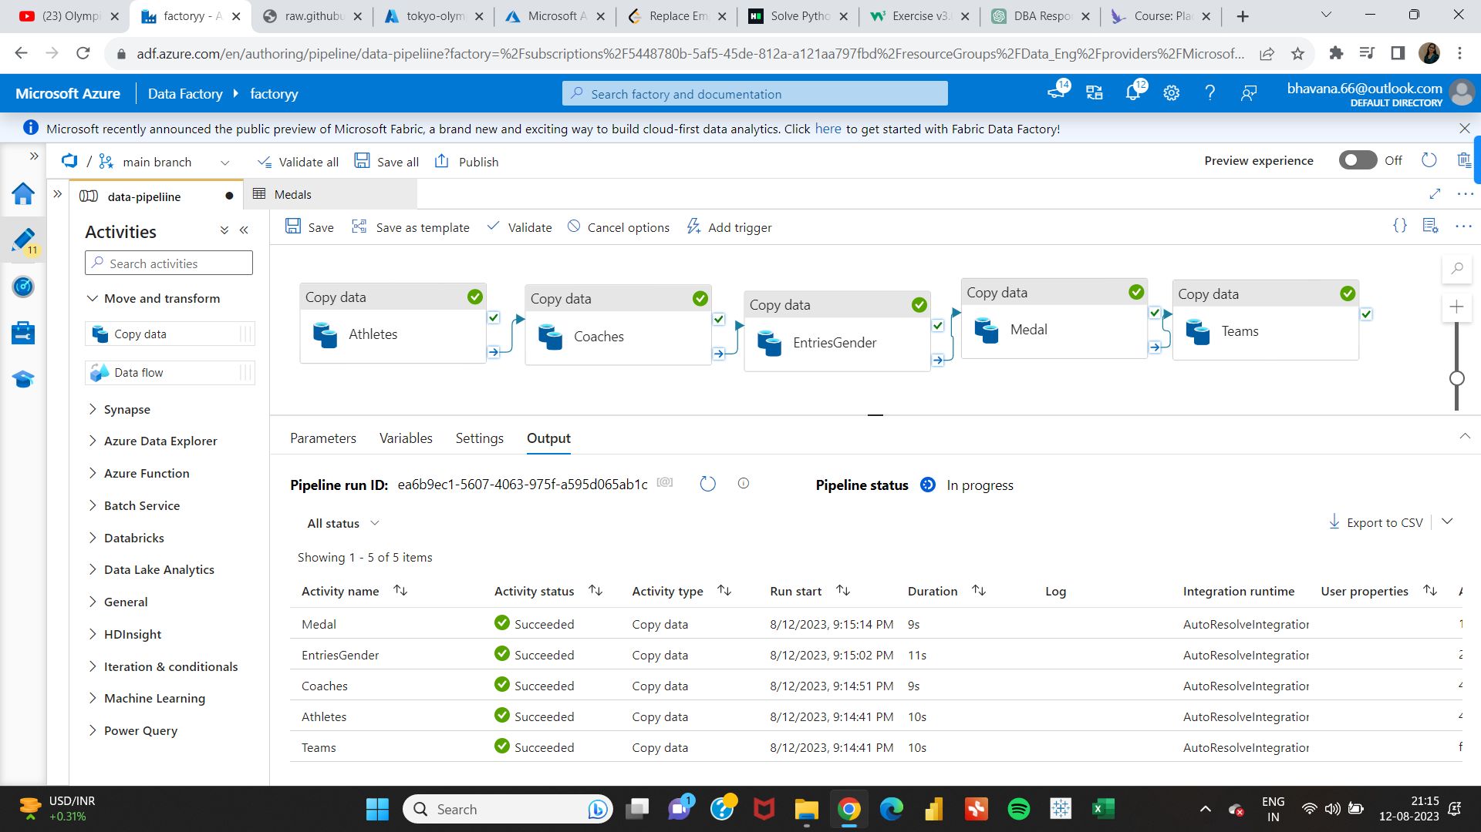

Slide 9
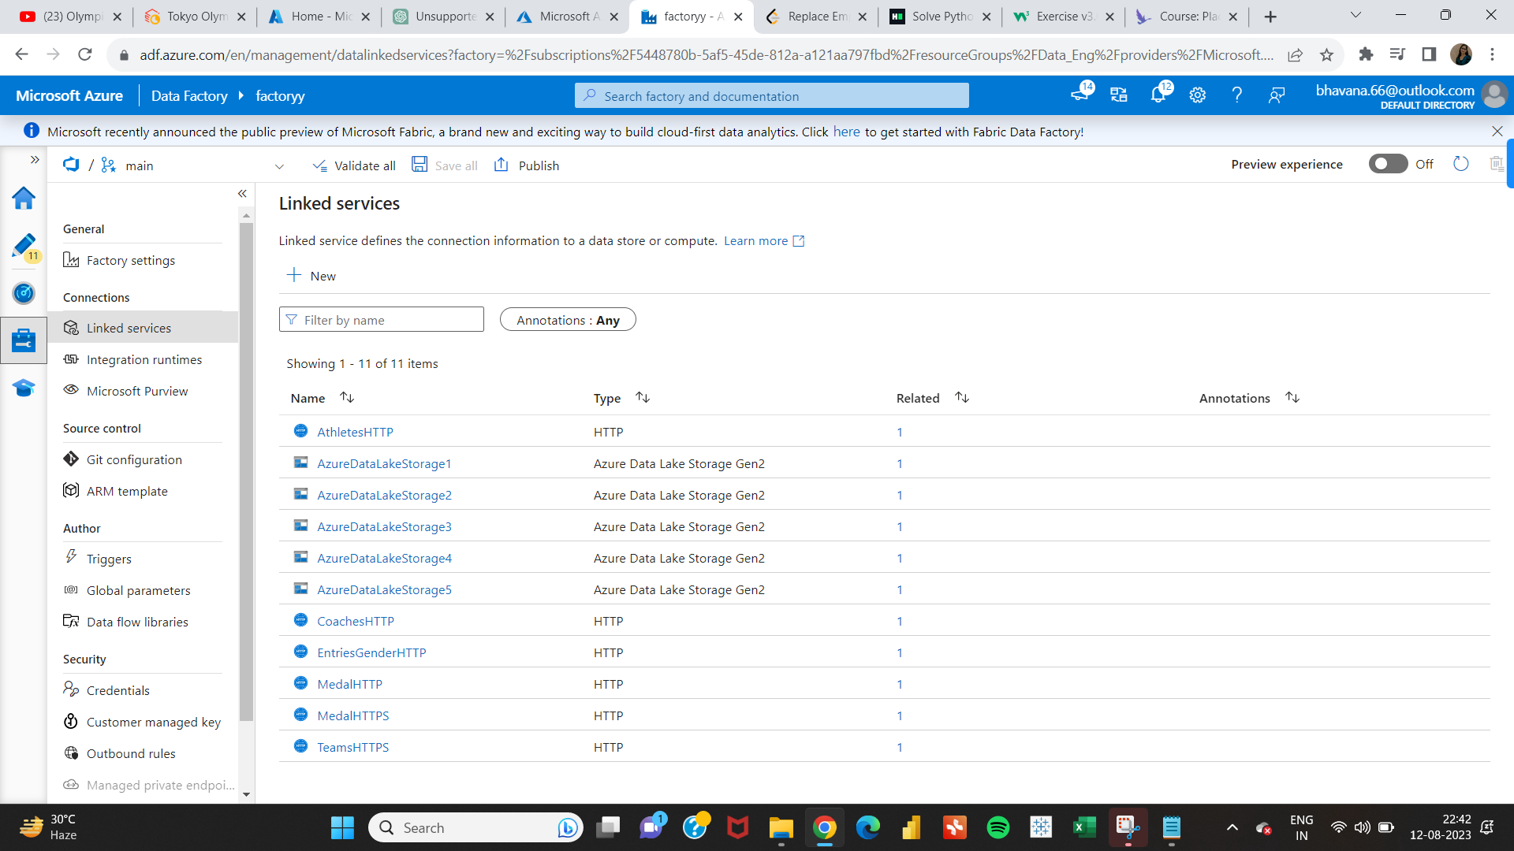

Slide 10
Adls gen-2 storage account
Welcome to the realm of Azure Data Lake Storage Gen2 (ADLS Gen2) storage accounts, where data lakes are infused with the unmatched power of scalability and efficiency. As we navigate the landscape of Olympic data, ADLS Gen2 emerges as the cornerstone of our data storage and management strategy. This robust storage solution serves as the bedrock for hosting both raw and processed Olympic data, allowing us to seamlessly manage structured and unstructured information on a grand scale. Join me as we dive into the capabilities of ADLS Gen2 storage accounts, witnessing how they shape the foundation of our data-driven journey.

Slide 11
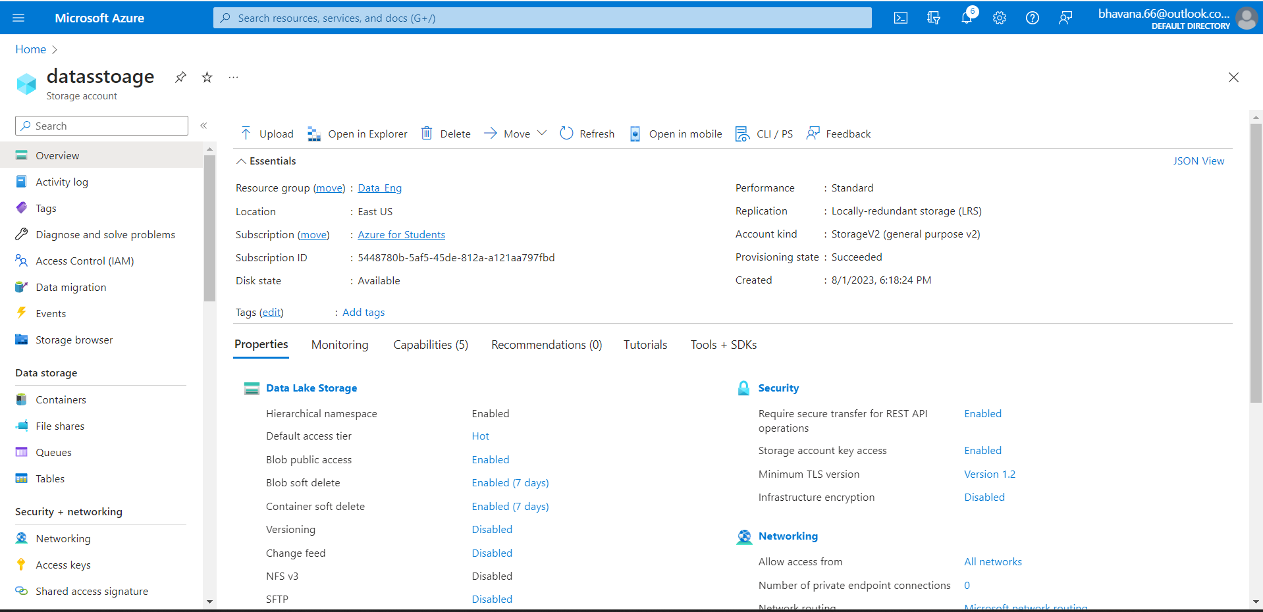

Slide 12
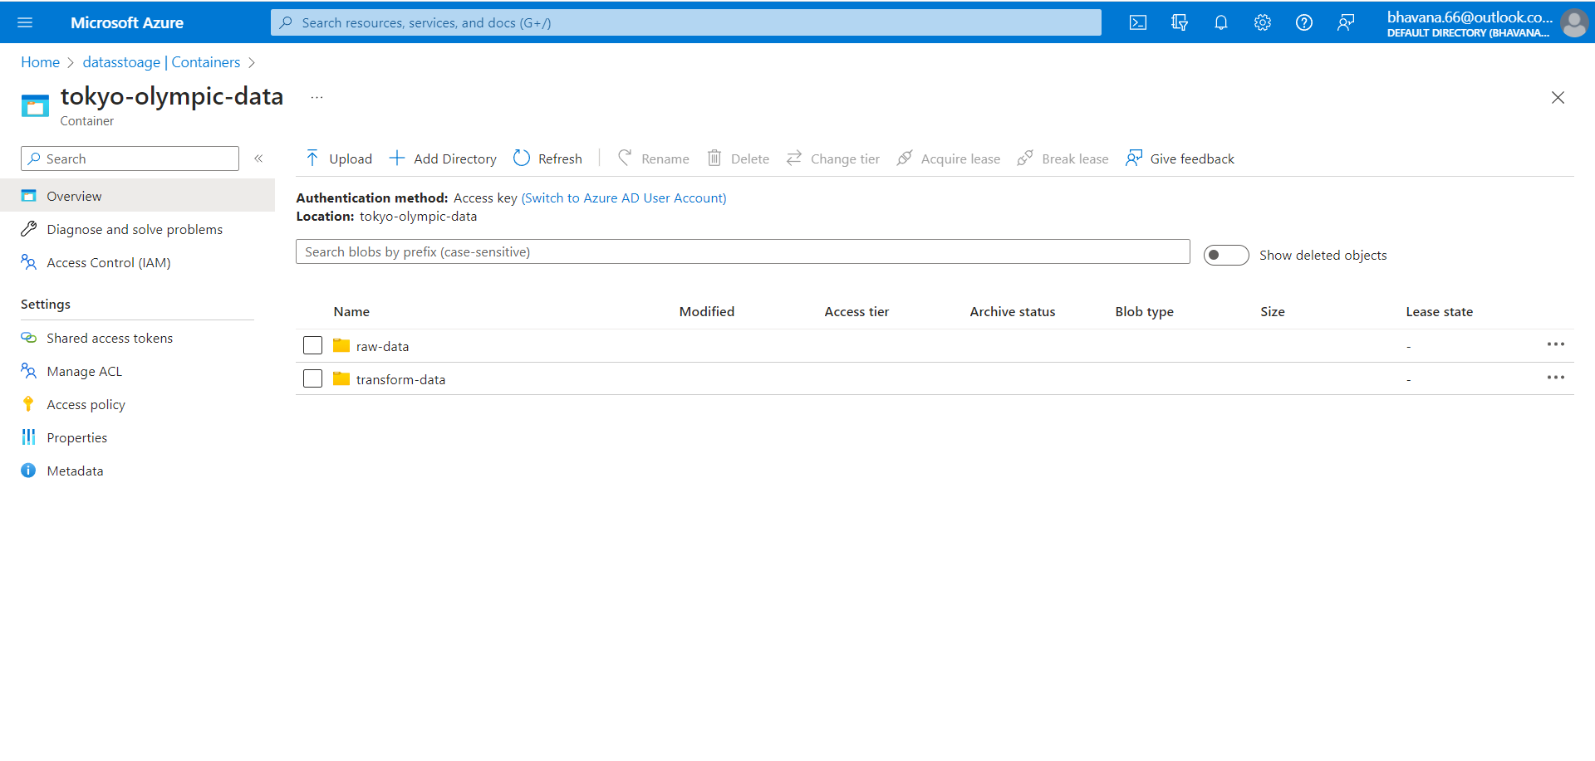

Slide 13
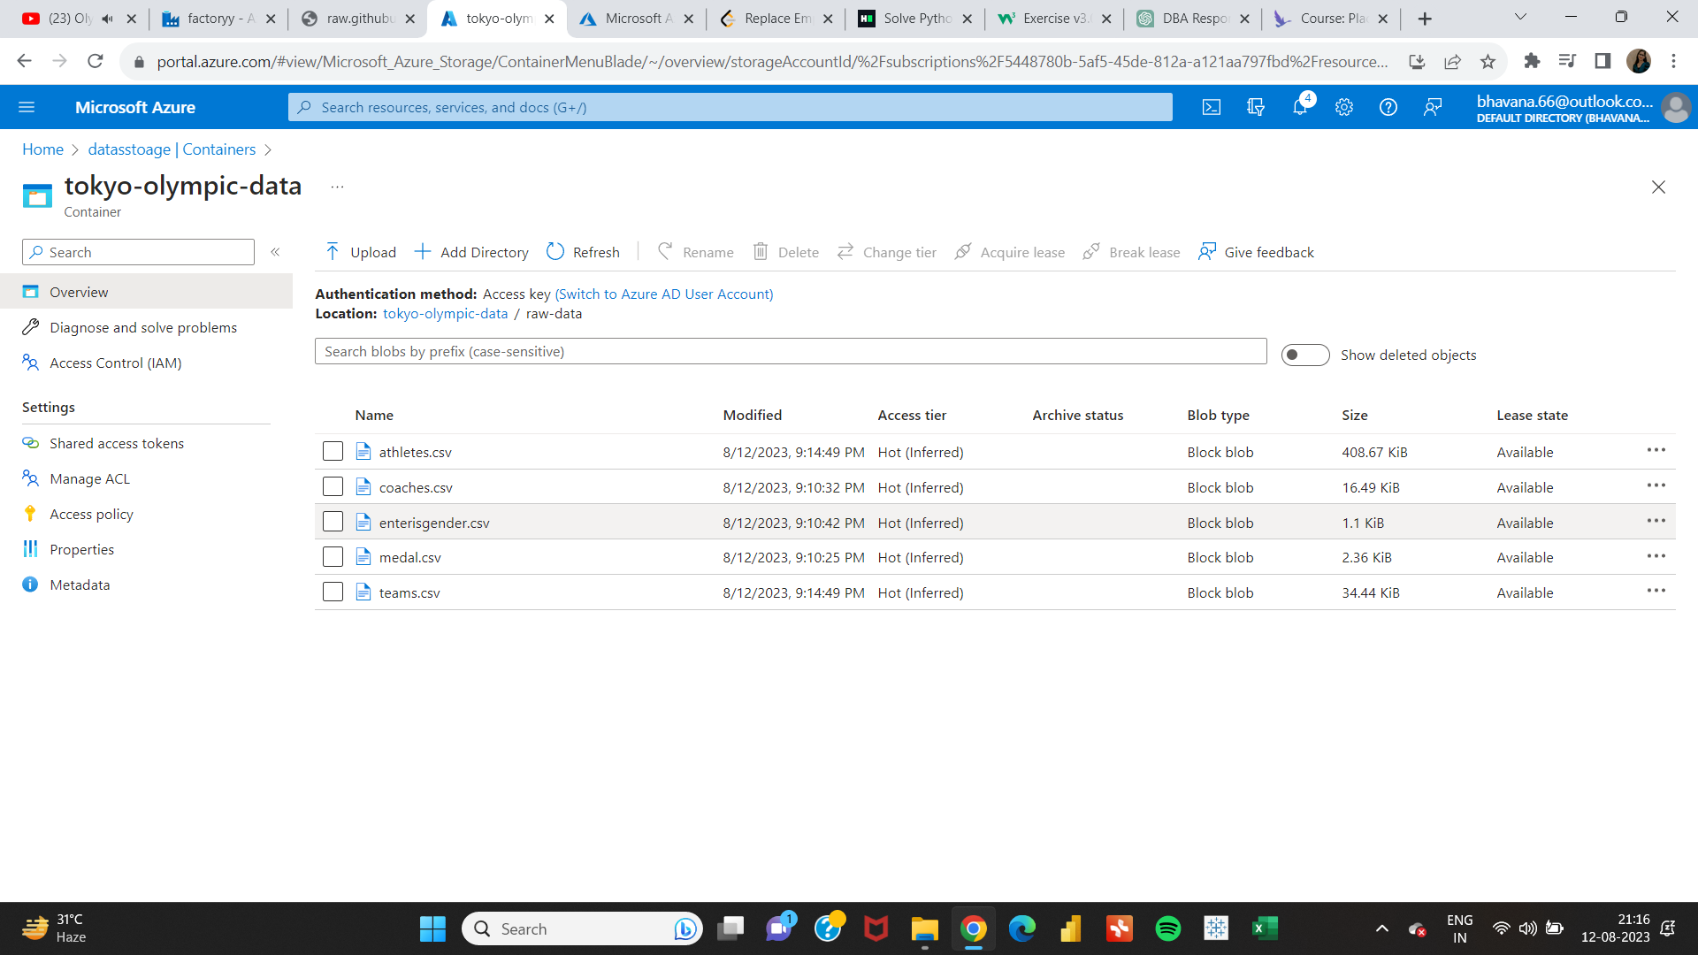

Slide 14
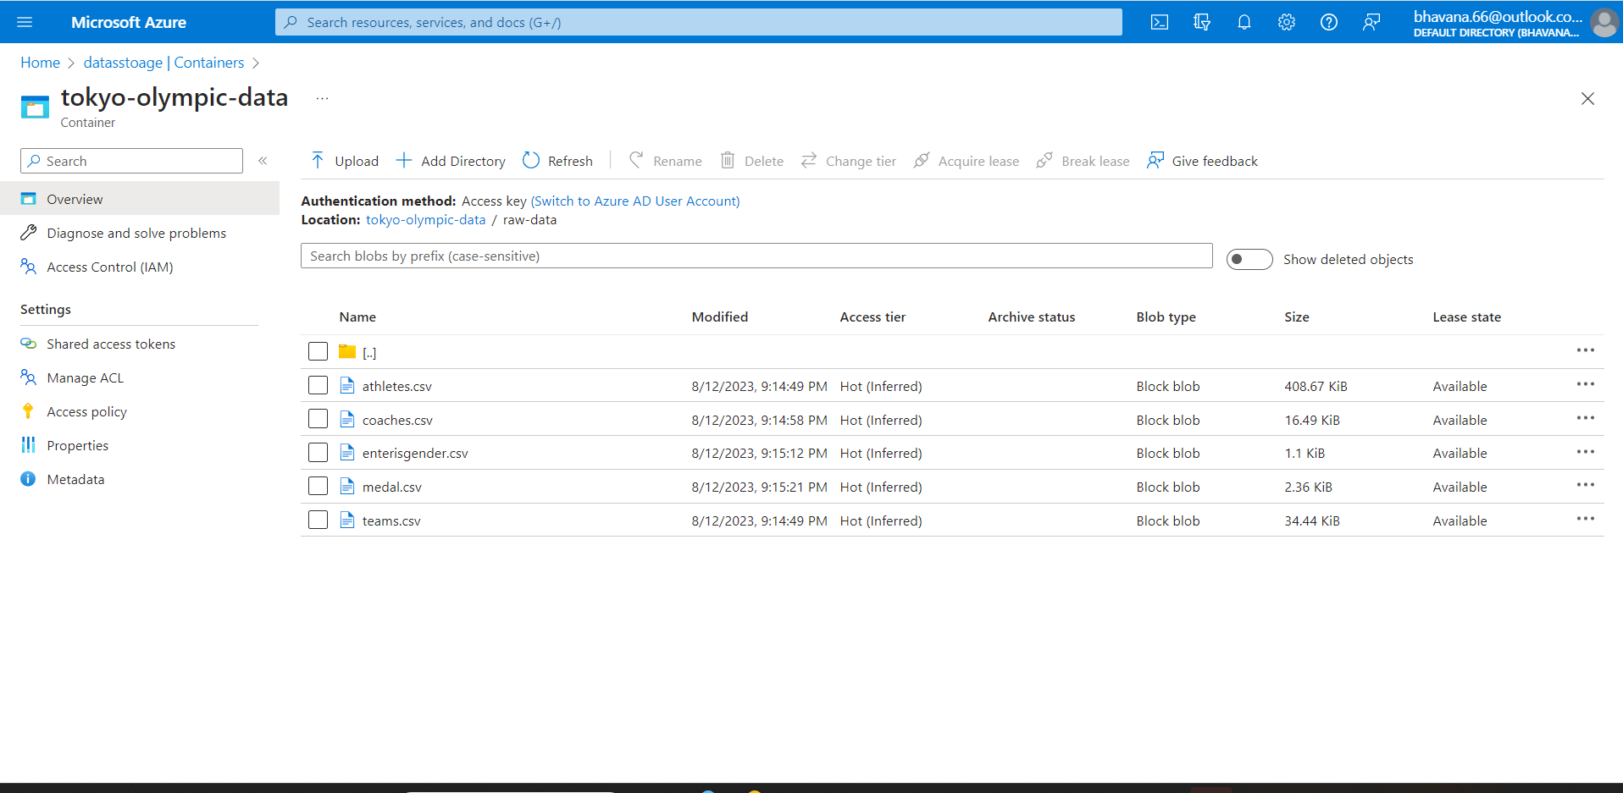

Slide 17
Creating Azure databricks
Welcome to the world of Azure Databricks, where data exploration transcends boundaries and advanced analytics take center stage. As we journey through Olympic data, Azure Databricks emerges as our beacon of insight, transforming raw information into valuable understanding. This collaborative Apache Spark-based platform enables us to orchestrate complex data transformations, execute machine learning models, and engage in interactive data exploration. Join me as we unravel the capabilities of Azure Databricks, witnessing how it empowers us to distill Olympic data into actionable insights.

Slide 18
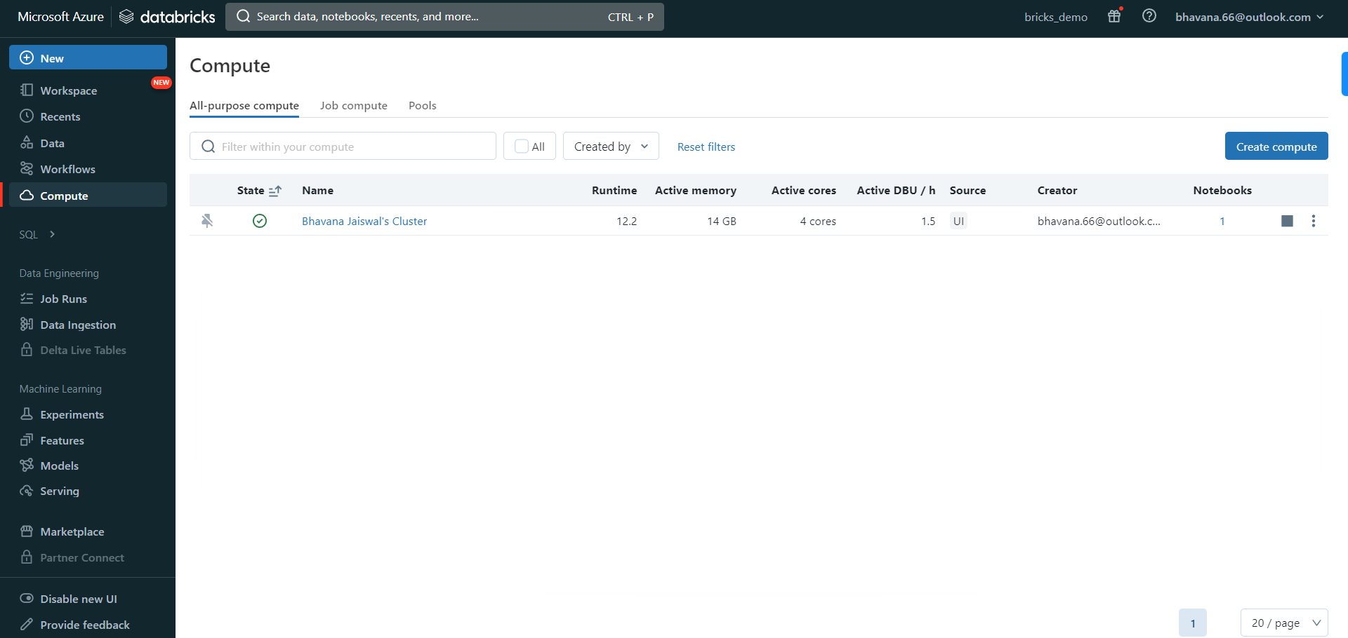

Slide 19
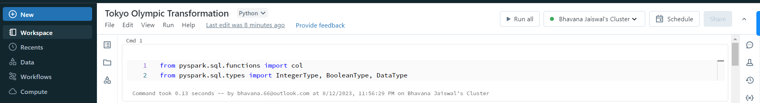

Slide 20
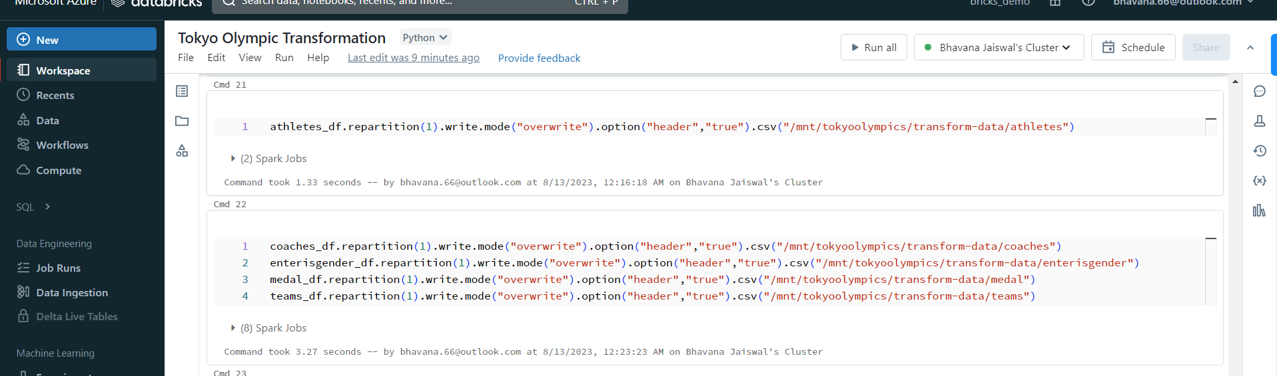

Slide 21
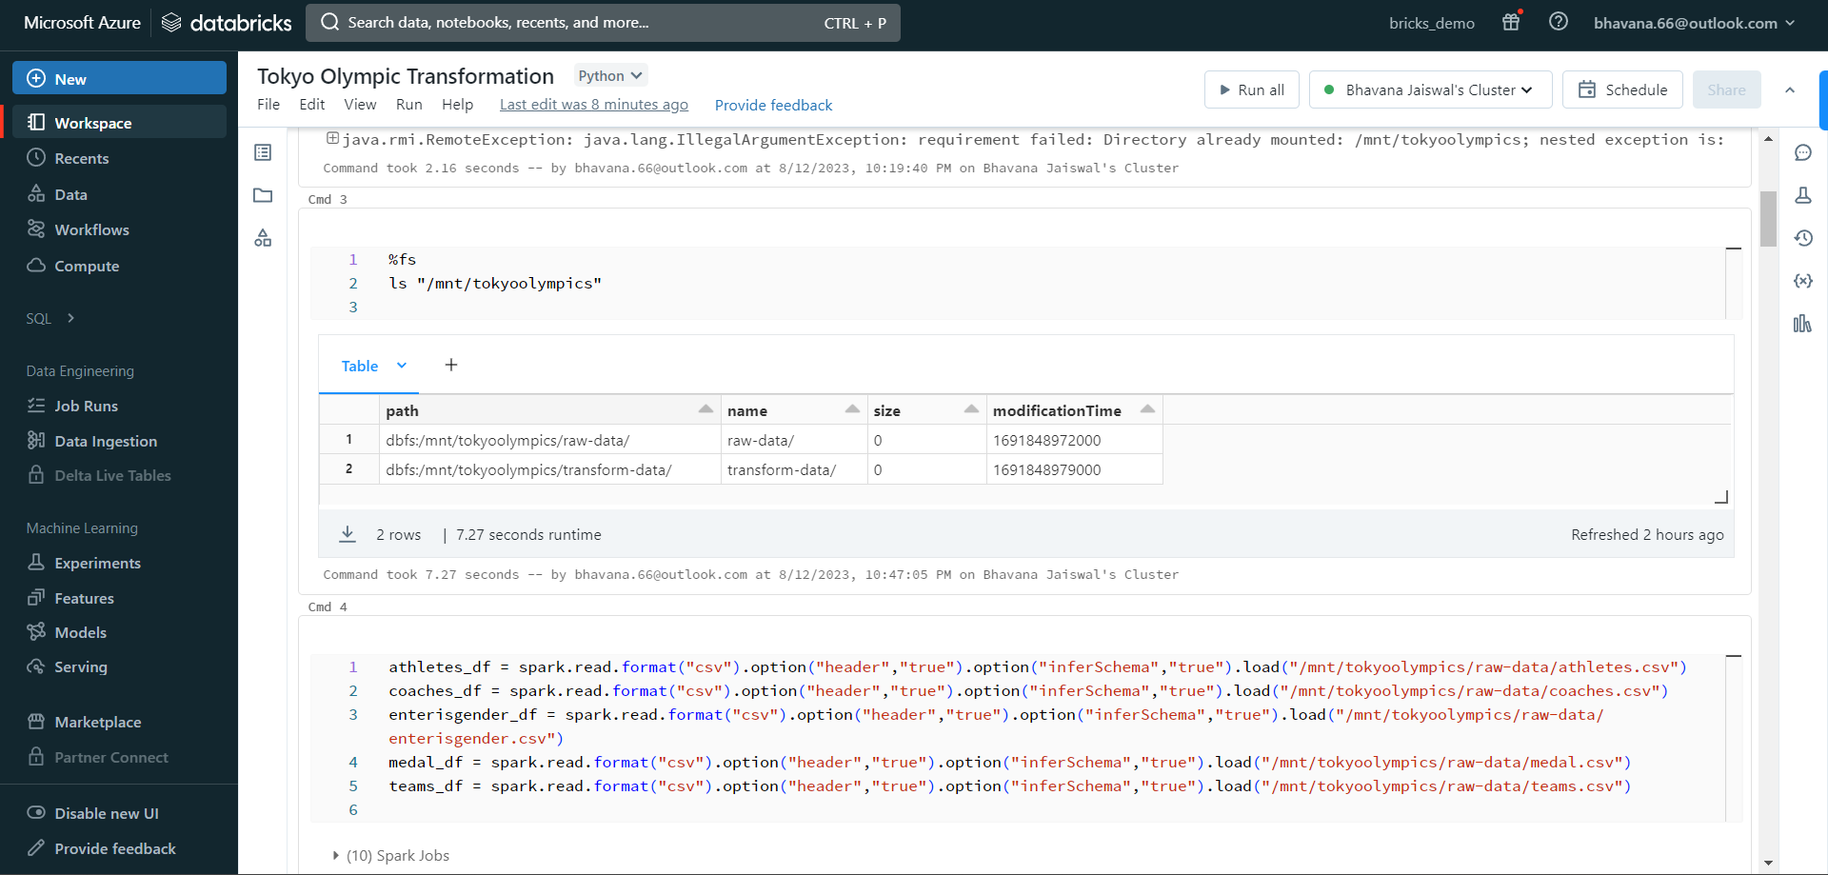

Slide 22
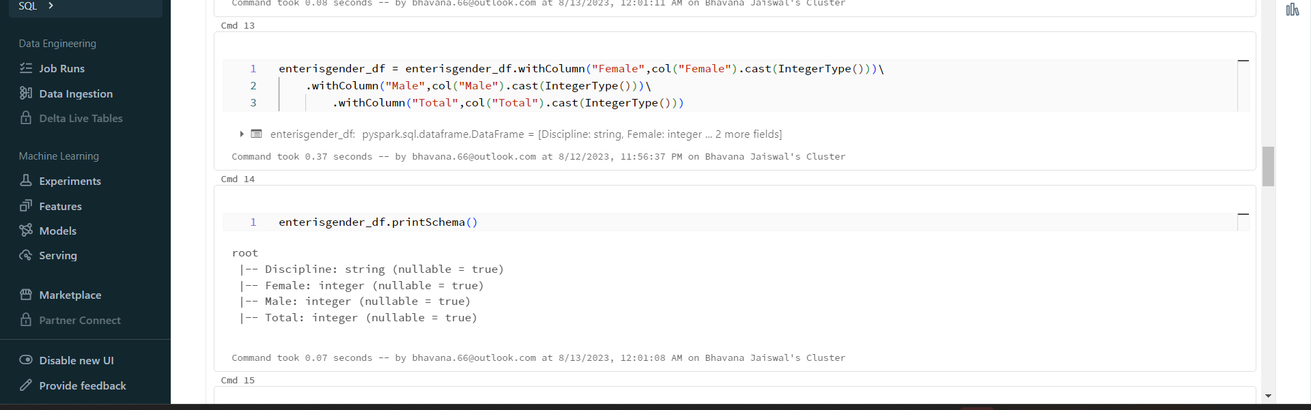

Slide 23
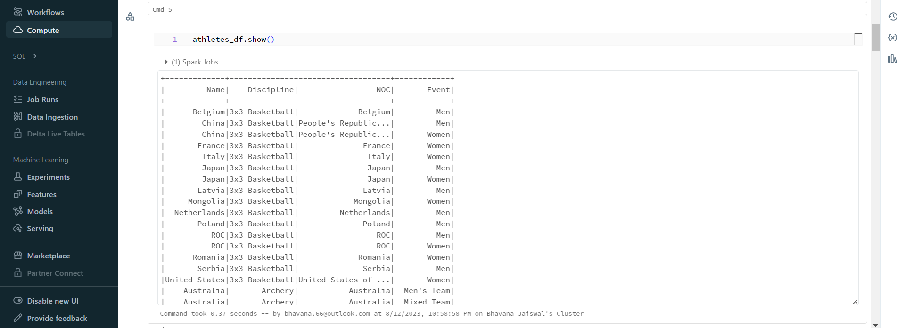

Slide 24
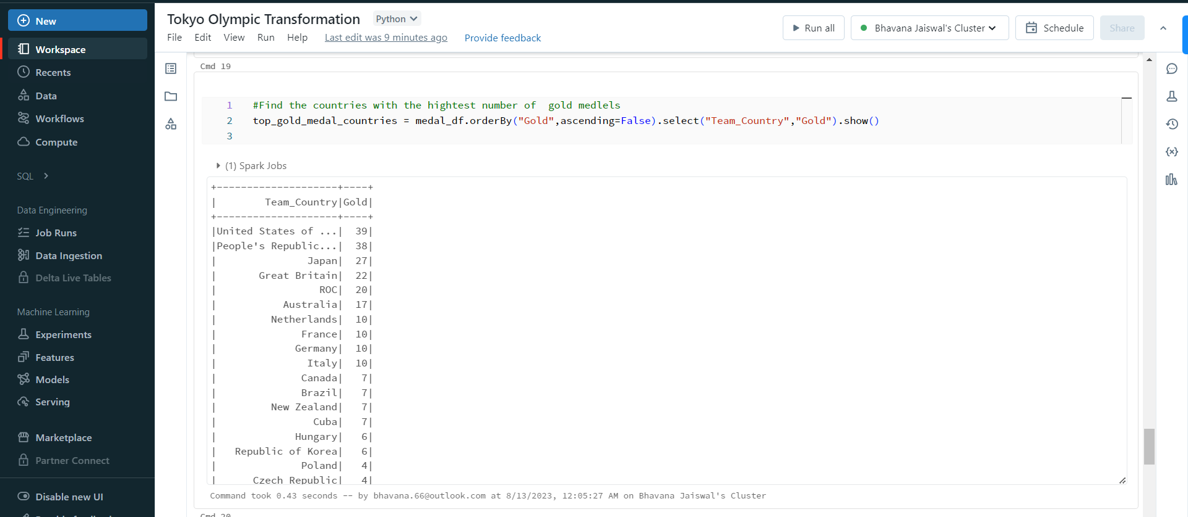

Slide 25
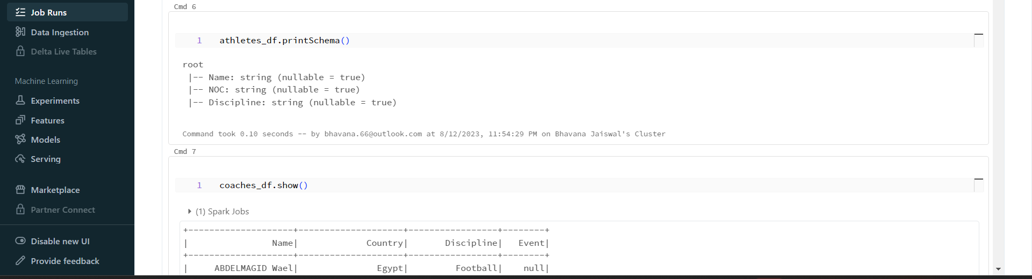

Slide 26
Getting back all the transform data
The journey from data exploration to actionable insights reaches its pinnacle with the harmonious integration of Azure Databricks and Azure Data Lake Storage Gen2 (ADLS Gen2). As we transform raw data into valuable insights within Azure Databricks, the synergy continues as we effortlessly funnel these insights back to ADLS Gen2. This seamless transition ensures our refined outcomes are securely stored, scalable, and ready for the next stage of our data-driven journey. Join me as we witness the culmination of data exploration and storage, all within the cohesive embrace of Azure's transformative technologies.

Slide 27


Slide 28
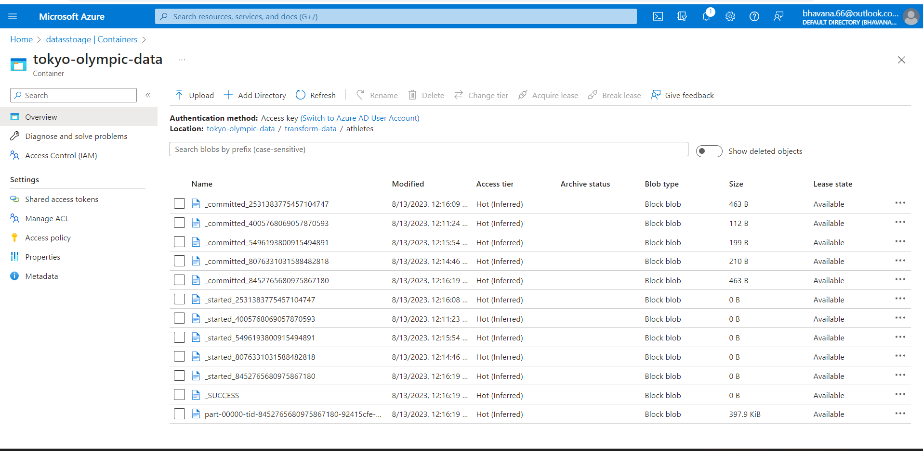

Slide 29
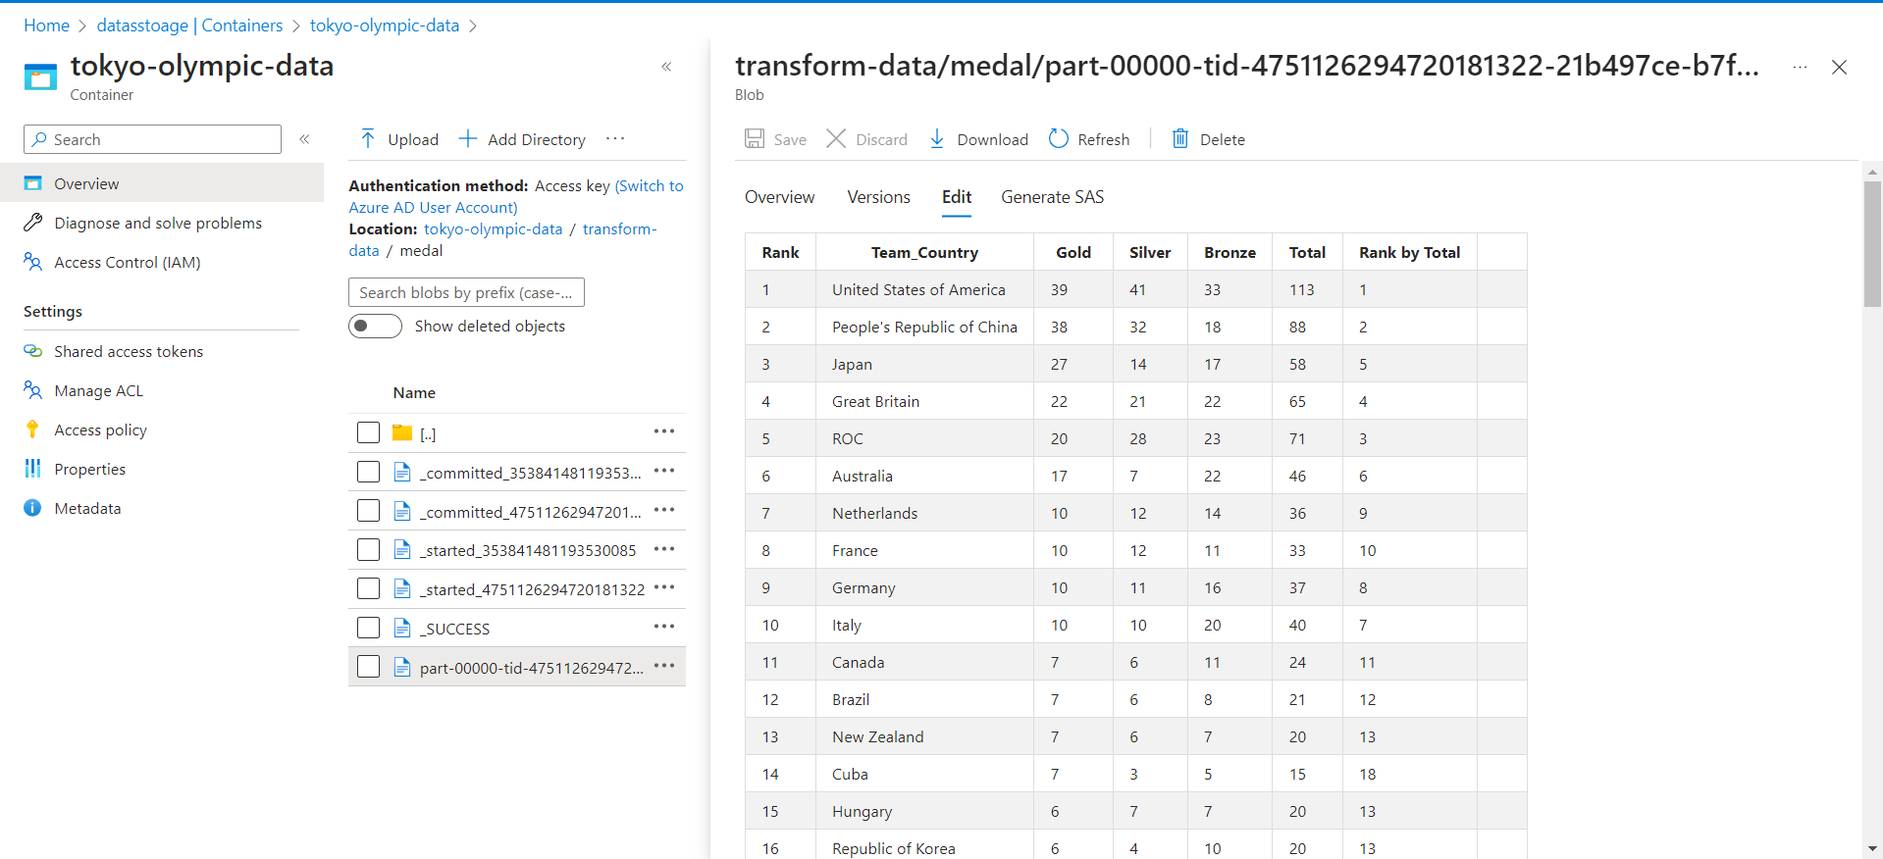

Slide 30
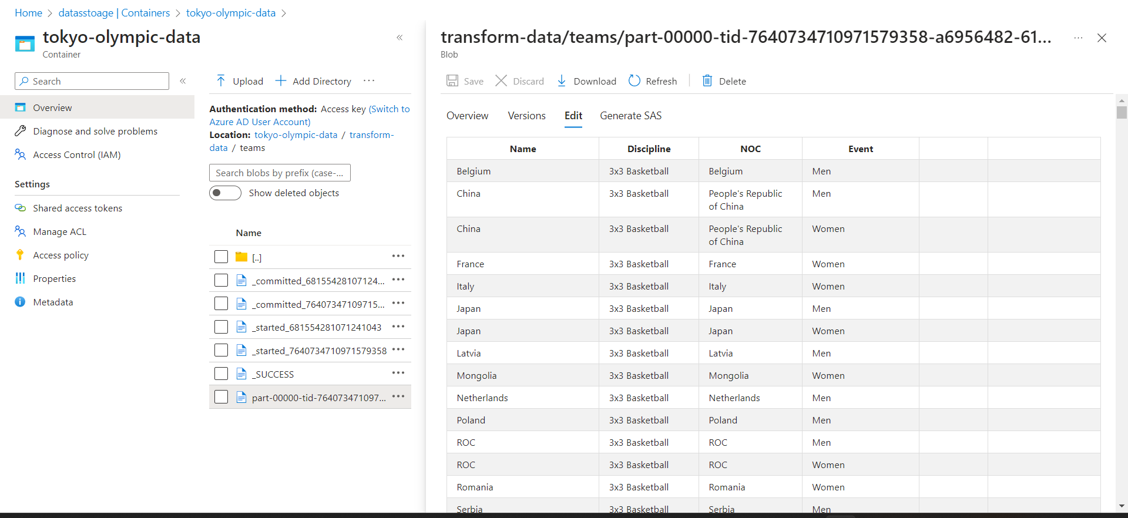

Slide 31
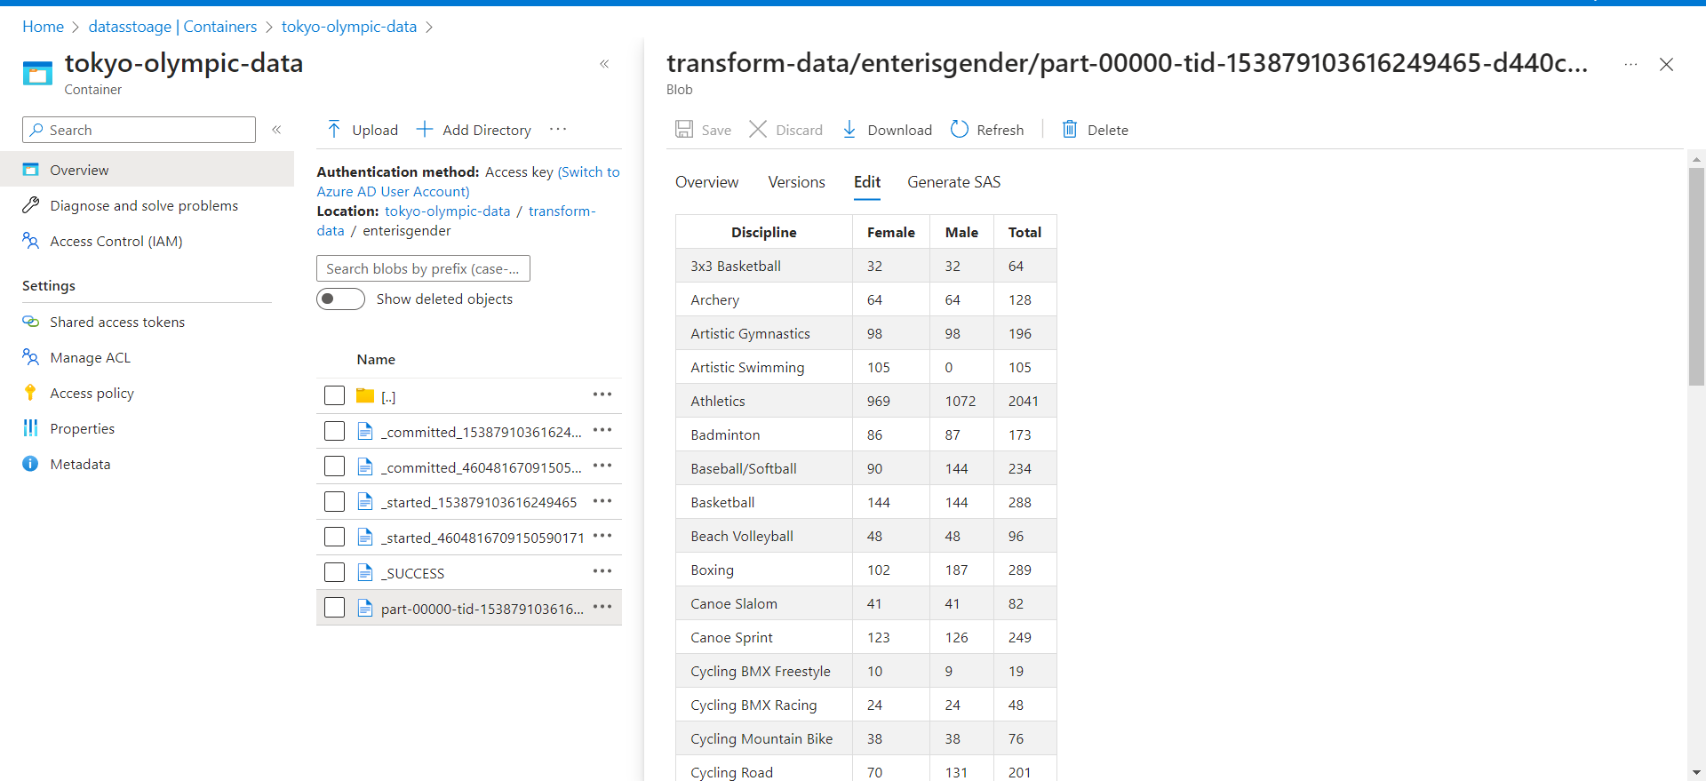

Slide 32
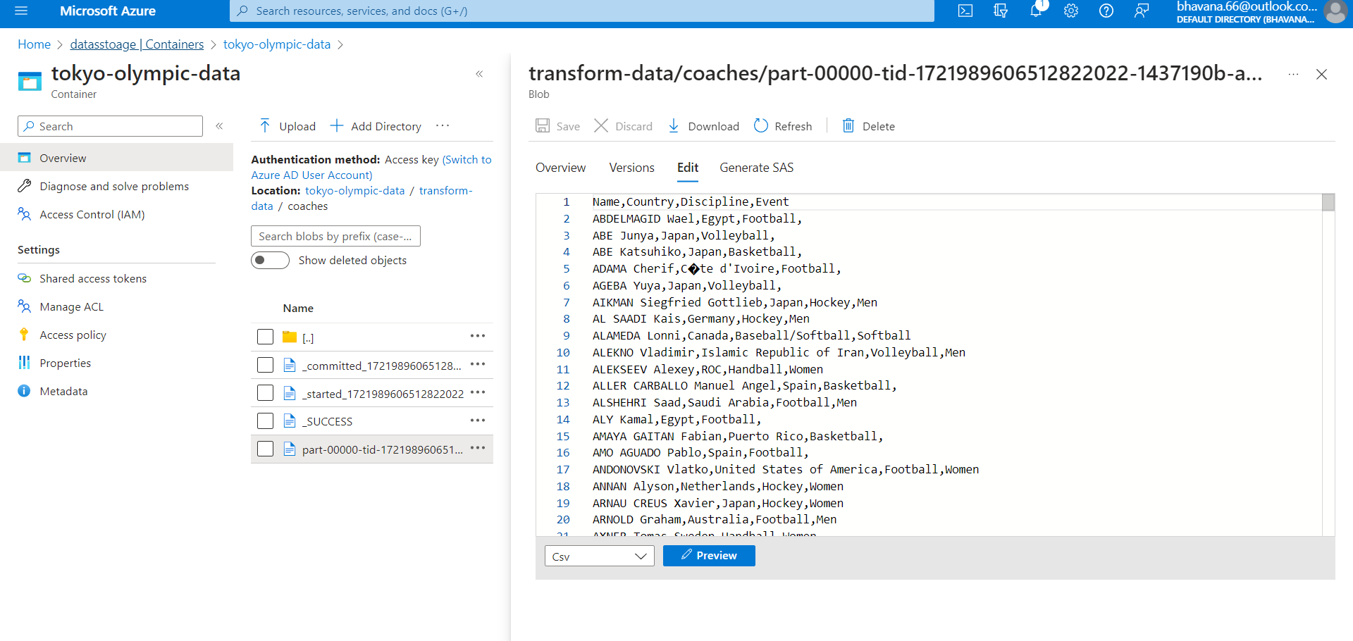

Slide 33
Creating azure synapse analytics
Welcome to the realm of Azure Synapse Analytics, where data analysis transcends boundaries and historical insights come to life. In our exploration of Olympic data, Azure Synapse Analytics serves as the backbone of our analytical endeavors. Formerly known as SQL Data Warehouse, this comprehensive solution enables us to seamlessly analyze vast datasets, uncover historical trends, and extract meaningful athlete performance metrics. Join me as we dive into the capabilities of Azure Synapse Analytics, where unified analytics seamlessly converge to illuminate Olympic insights.

Slide 34
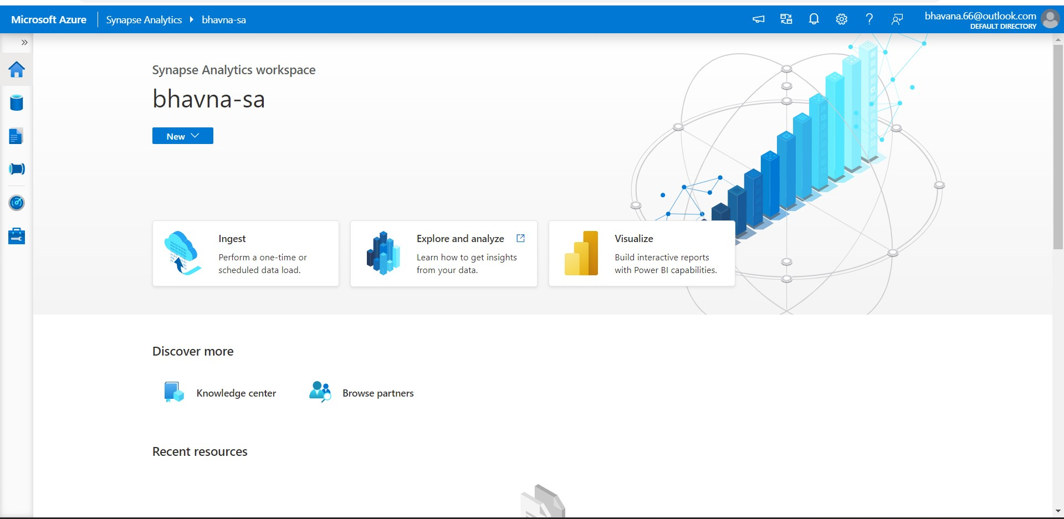

Slide 35
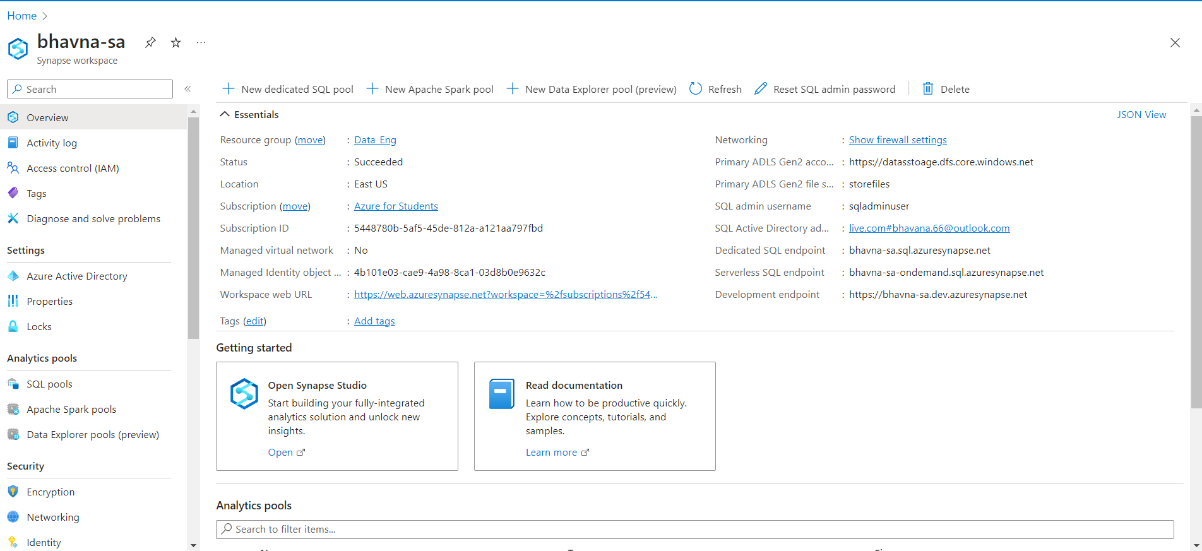

Slide 36
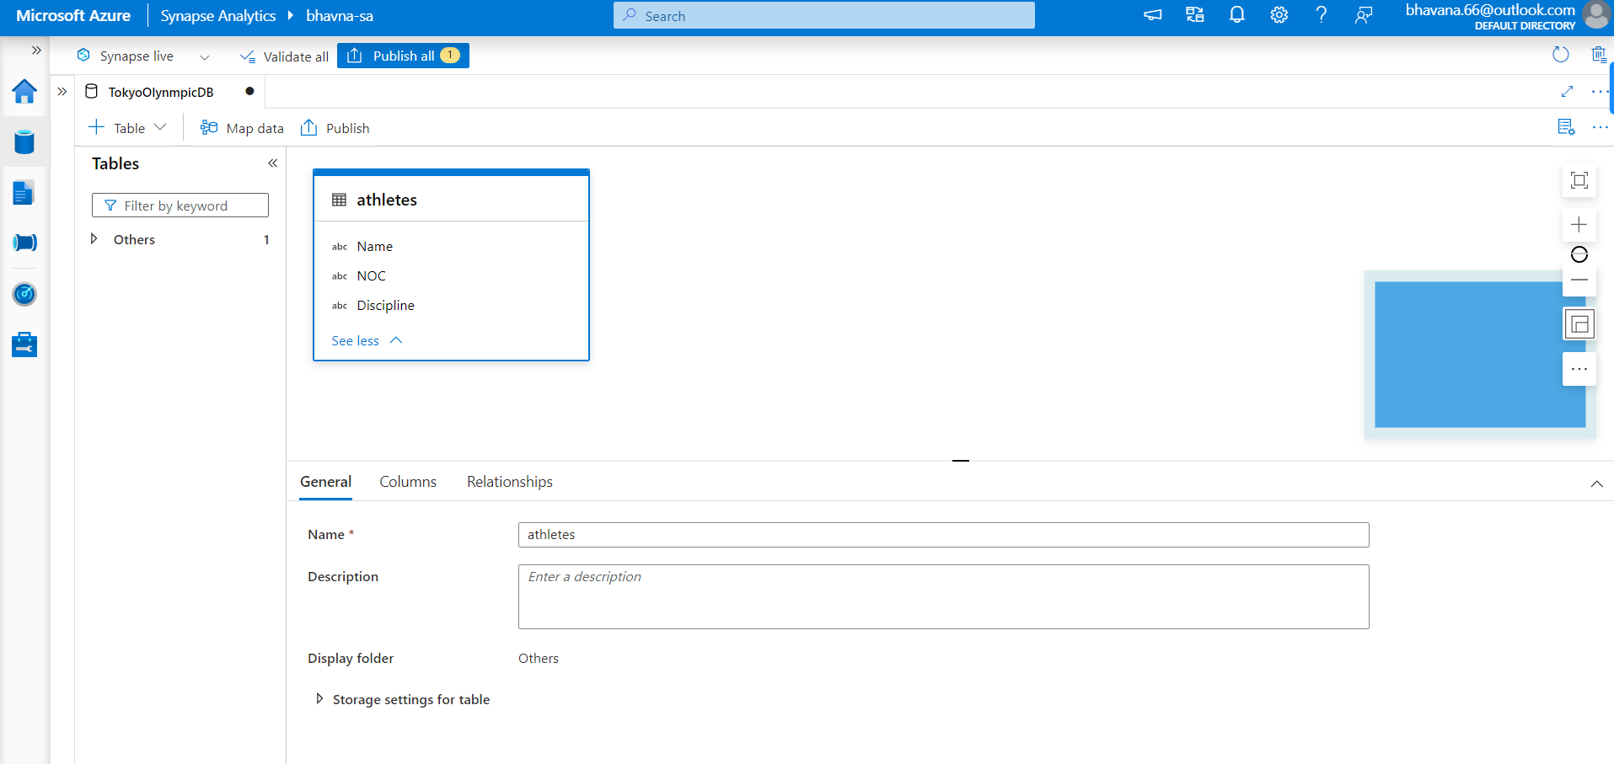

Slide 37
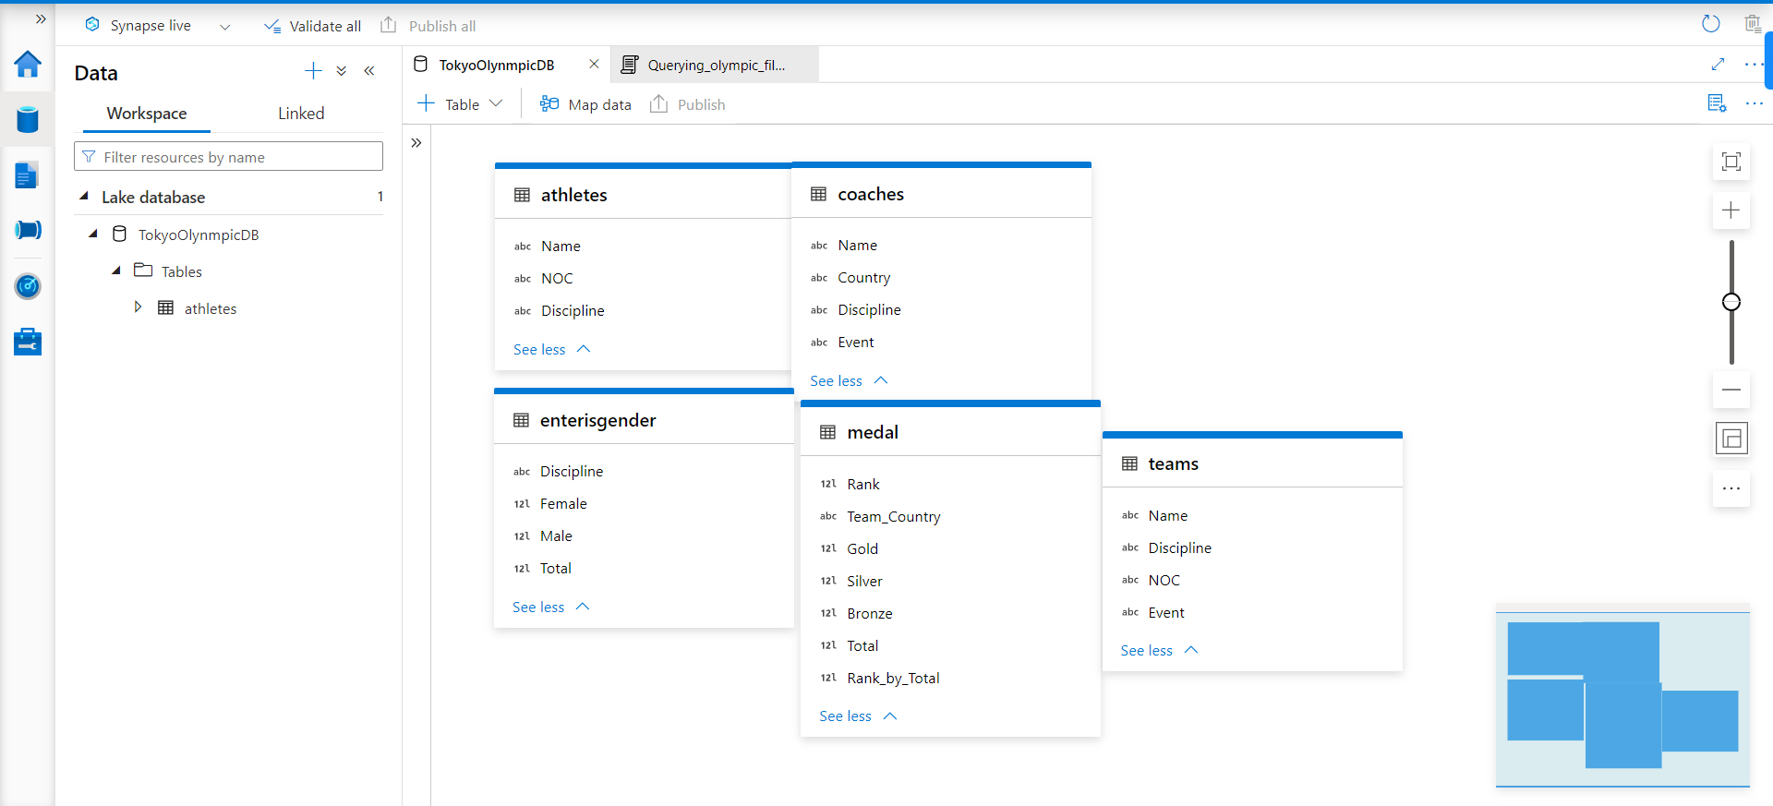

Slide 38
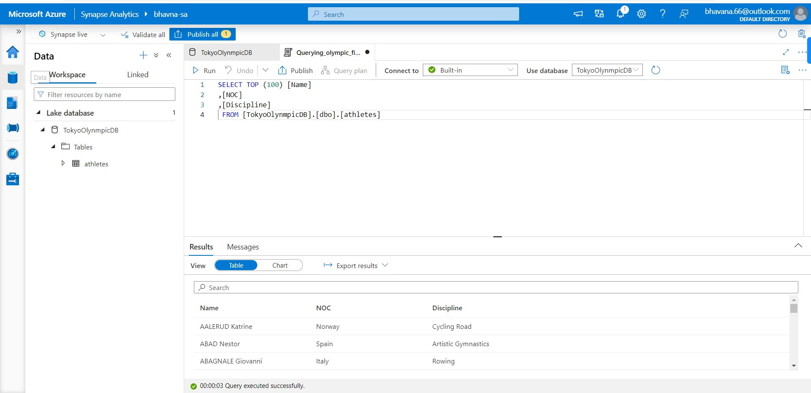

Slide 39
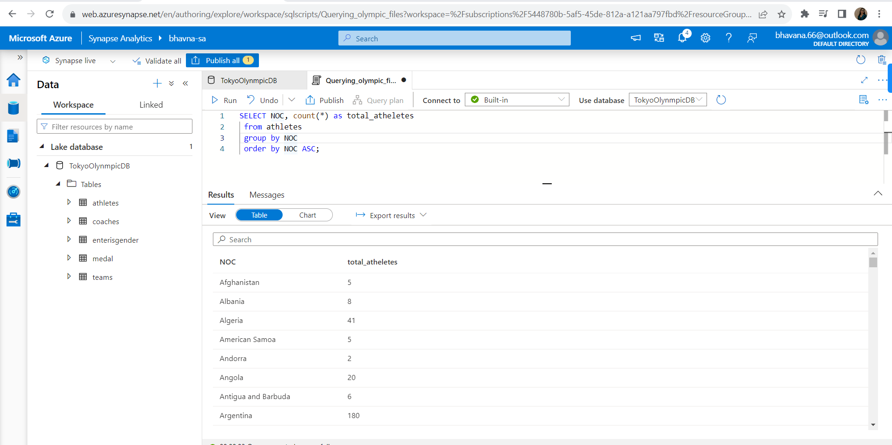

Slide 40
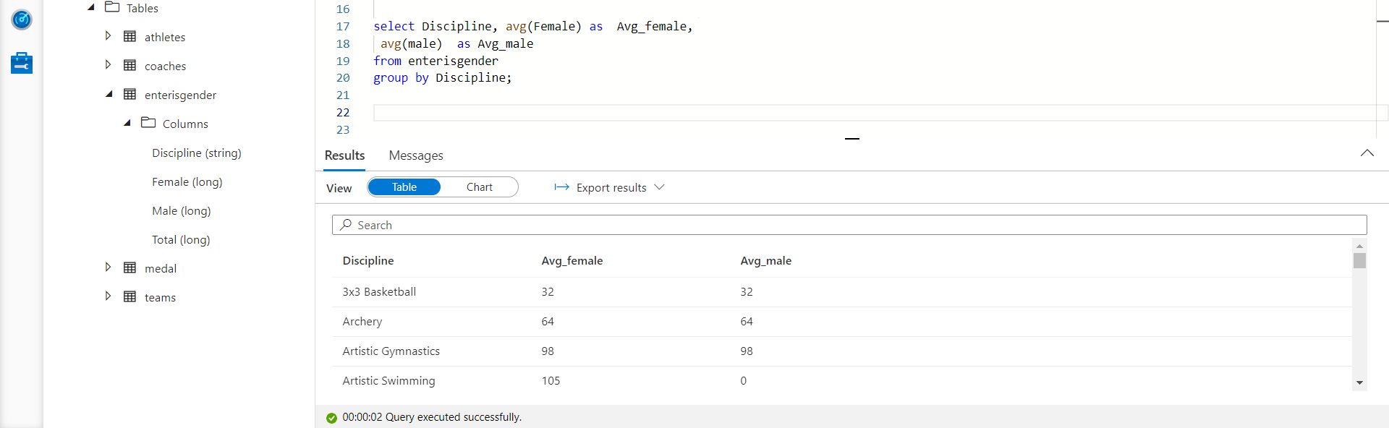

Slide 41
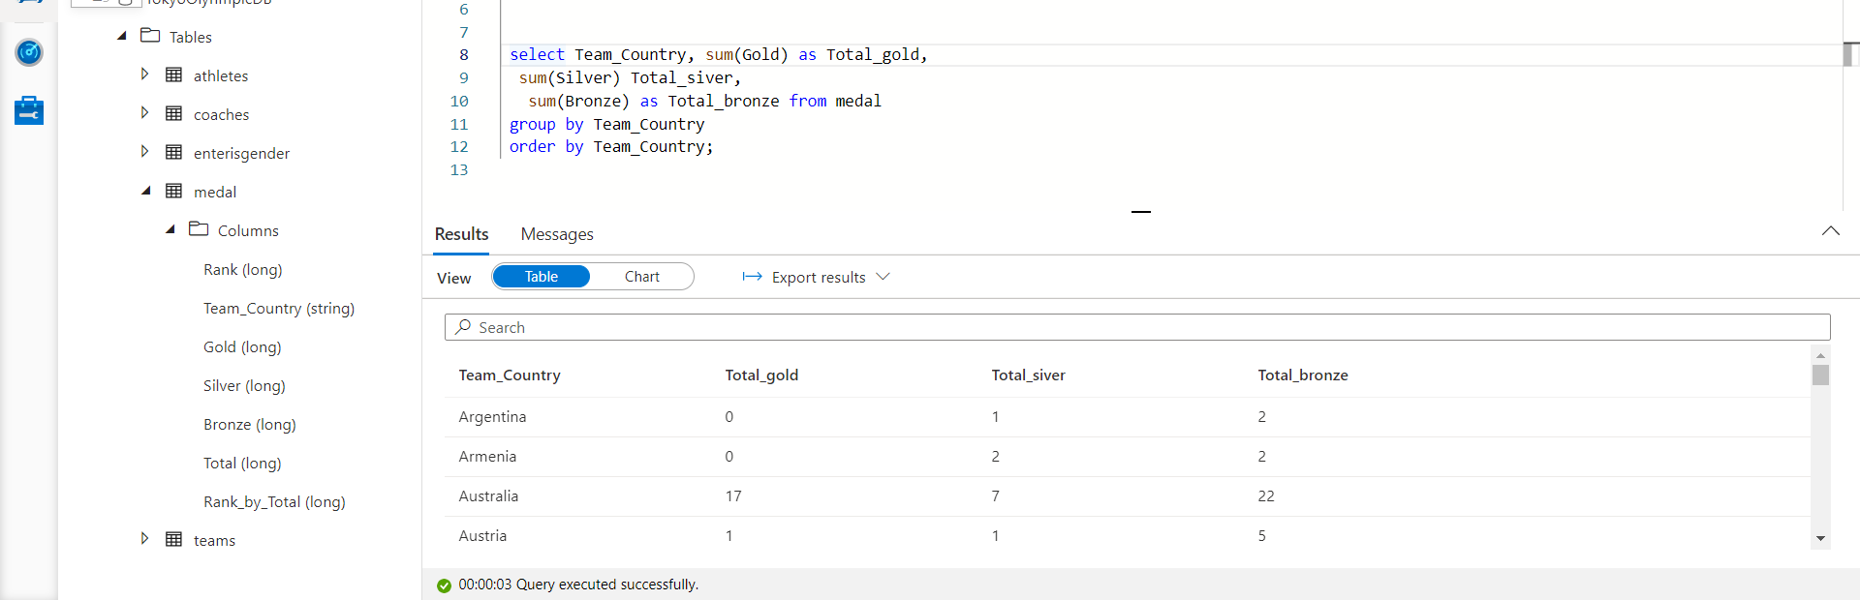

Slide 42
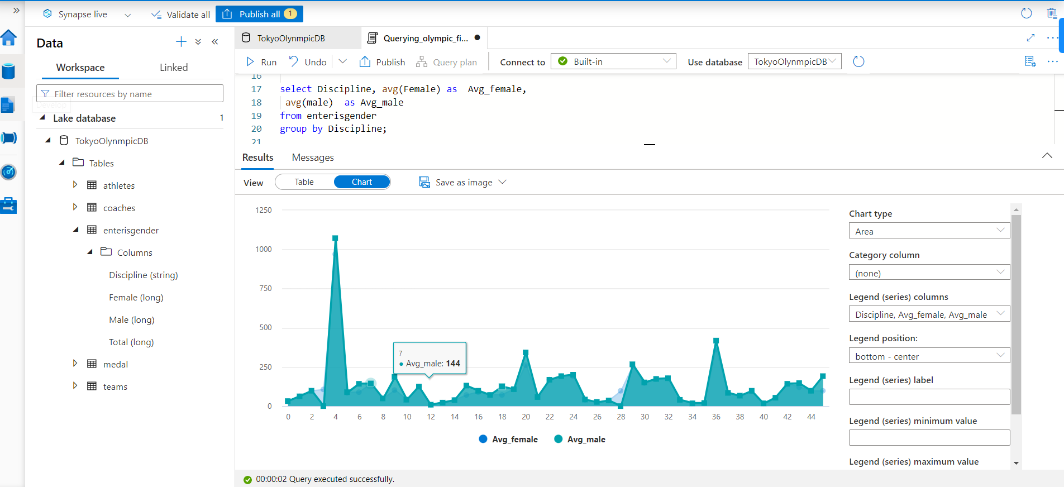

Slide 43
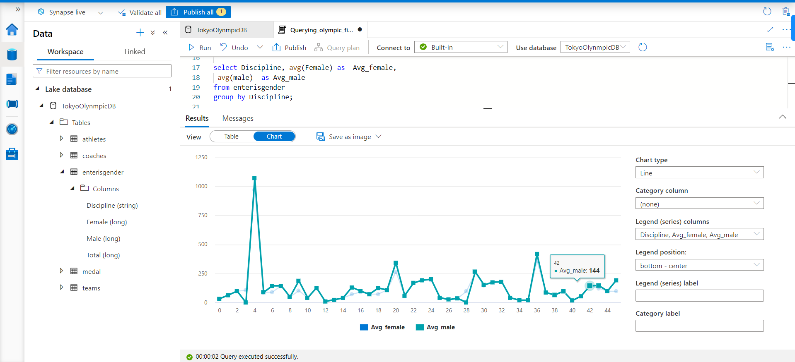

Slide 44
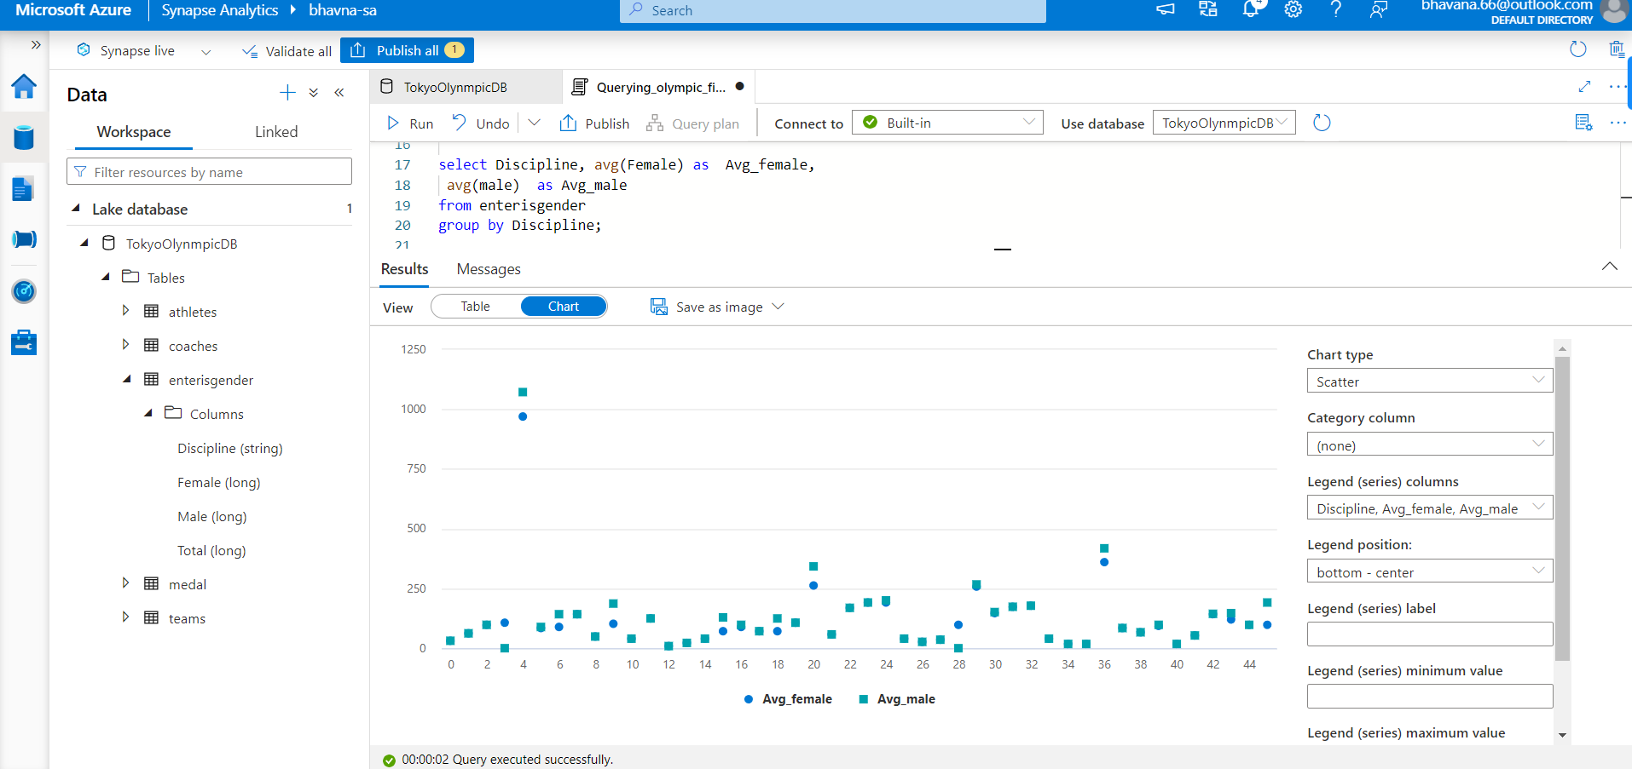

Slide 45
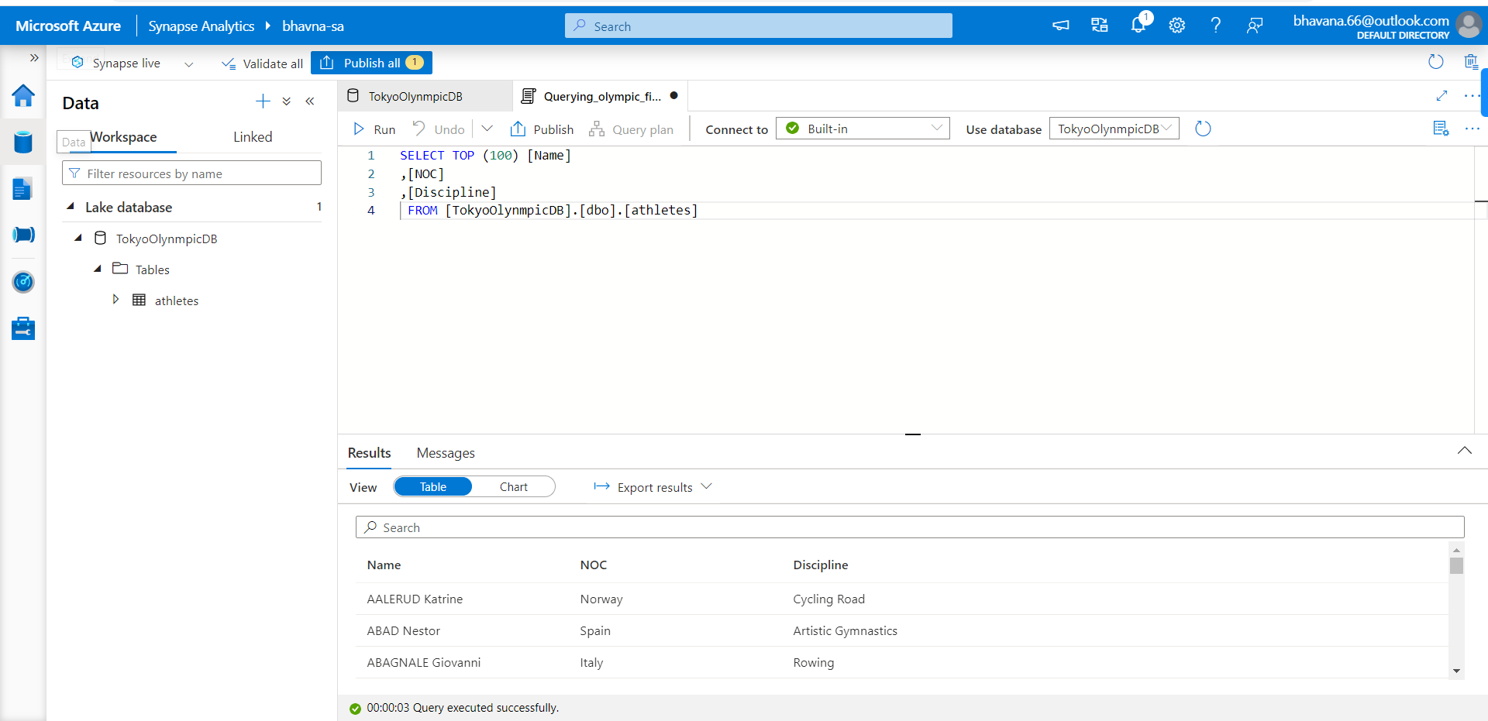

Slide 46
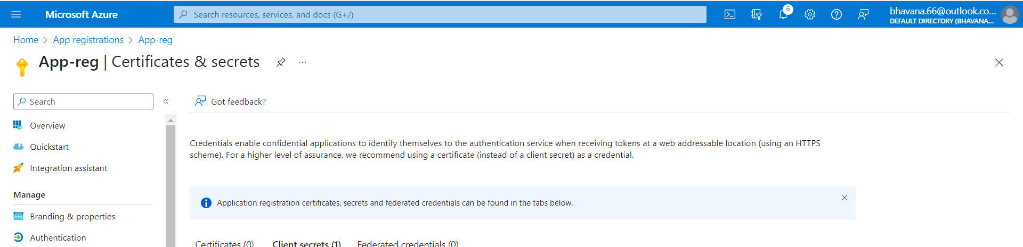

Slide 47
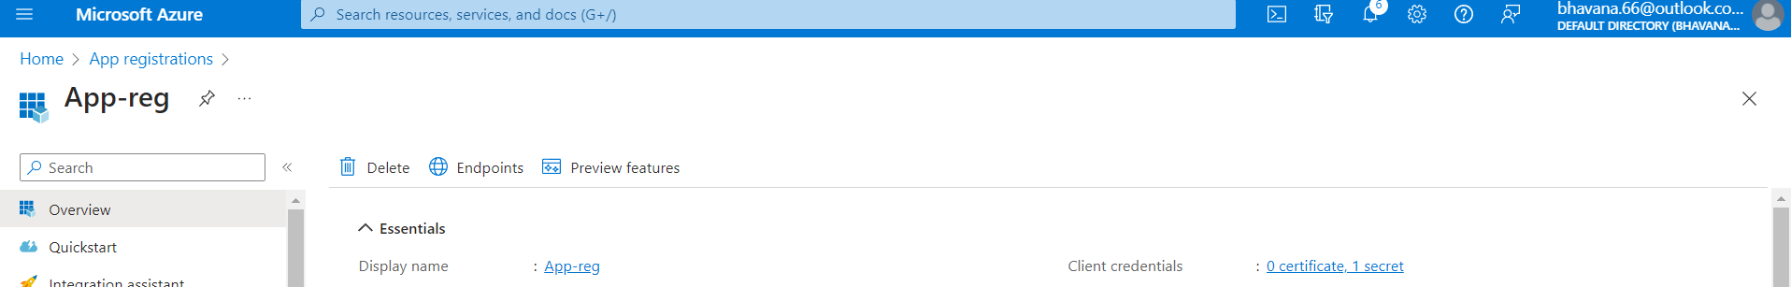

Slide 48
Thank You

